Slide 1
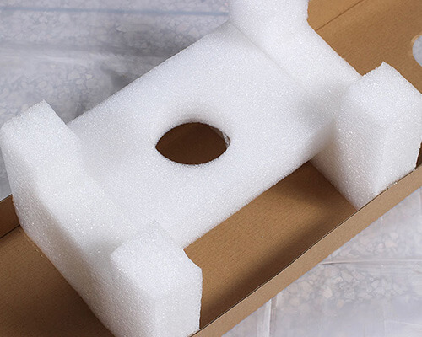
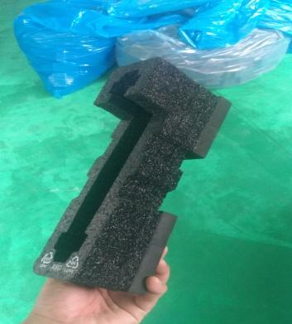
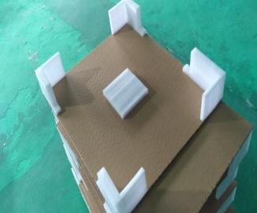
Application Products
EPE Foam is a new type of environmentally friendly packaging material. It can effectively absorb impact forces and plays a good protective role for fragile and vulnerable items.
The "UNISN" EPE foam hot - melt adhesive is mainly applied to the bonding and shaping of EPE Foam. It can also be used for the coating and bonding between EPE Foam and various materials such as cardboard, EVA materials, and flannelette.

Slide 2
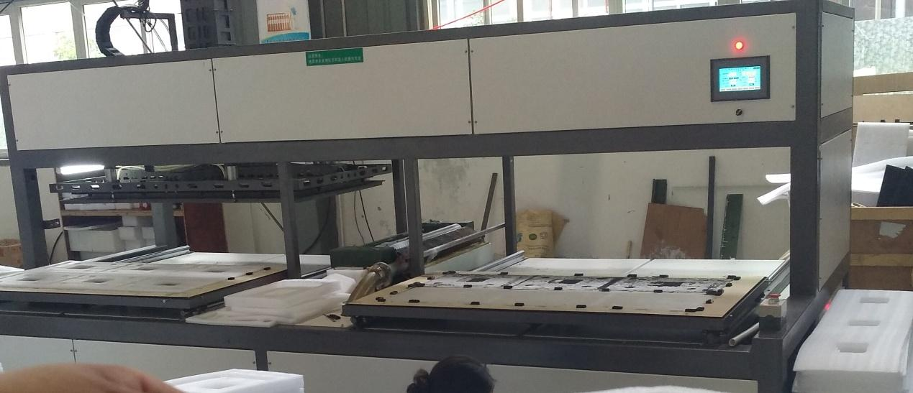
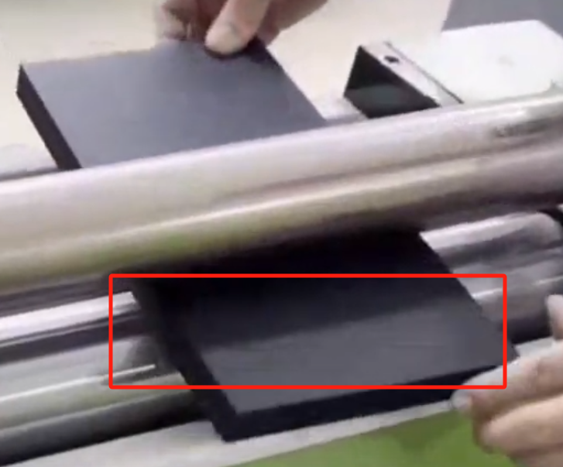
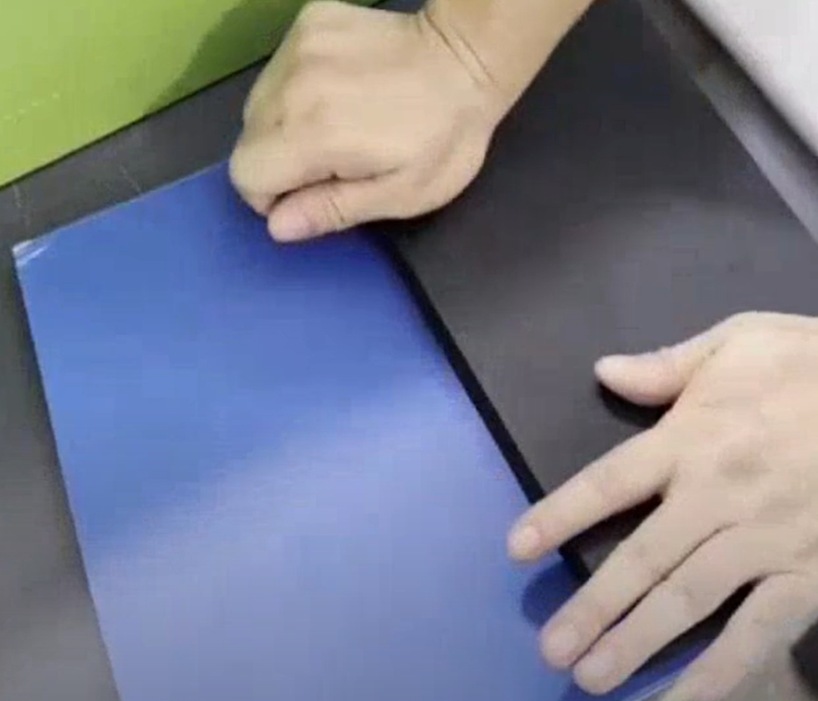
Application Equipment
Manual Glue - spreading Machine: Multiple operators can work on one machine; Low equipment investment cost; Wide applicability.
Automatic Coating and Gluing Machine: High efficiency and fast speed; The gluing machine is far from the operator, with less odor; No contact with the glue tank, reducing the risk of burns.
After the glue is coated on the surface of EPE Foam, it is bonded to other objects.

Slide 3
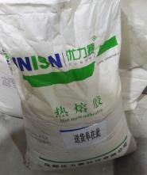
Why Choose UNISN Hot - melt Adhesive
Good Transparency: The overall visual effect of EPE Foam packaging will not be affected by the opacity of the hot - melt adhesive.
Low Odor: Reduces the impact of pungent odors on the health of operators and prevents the transfer of the packaging material's odor to the product.
Good Fluidity: It can be quickly and evenly coated on the surface of the adherend and fit well, ensuring the integrity of the bond.
Fast Curing Speed: Enables the adherends to be fixed quickly, greatly shortening the production cycle.
High Bonding Strength: It has good bonding performance with a variety of materials, ensuring that the bonded objects will not easily fall off or separate.
Good High - Temperature Resistance: It can still maintain good bonding strength and stability in a certain high - temperature environment, making it suitable for high - temperature applications.
Environmentally Friendly and Harmless: It is made from environmentally friendly raw materials, causing no pollution to human health and the environment. It can be widely used in fields with high environmental requirements.

Slide 4
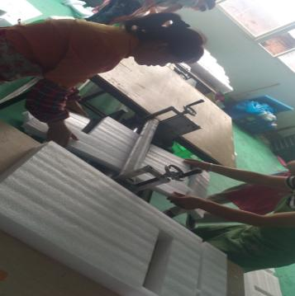
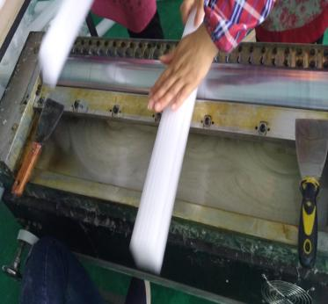
Usage Methods and Precautions
Open Time: 30 - 40 seconds
Operating Temperature Settings: Glue melting tank: 160 - 200°C; Coating roller: 150 - 180°C. Note: In cold environments, the hot - melt adhesive dissipates heat quickly, and the operating temperature of the hot - melt adhesive needs to be increased by at least 10°C.
In addition, the following precautions should be taken:
Pre - heat the glue - melting device for about 2 hours first.
Control the amount of glue added according to the production volume to prevent over - heating due to incomplete consumption over a long period, which may cause the glue to age and affect its adhesion. Also, avoid insufficient consumables, which may affect glue spraying.
The bonding work must be completed within the open time of the glue. Clamp the adherends until they are completely cooled and cured.
Since the glue - melting tank and the glue - spraying system are at high temperatures, safety protective equipment must be worn during operation to prevent burns.
The use place should be well - ventilated and kept away from open flames.
Avoid contact between the melted glue and parts such as eyes and skin.
If the melted glue comes into contact with the skin, immediately immerse the affected skin in cold water and rinse for at least 10 minutes. Seek medical treatment in a timely manner after cooling.

Slide 5
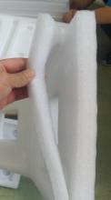
FAQ
Production Anomaly | Cause Analysis | Solutions
The glue - melting speed cannot keep up | The glue - melting temperature or the ambient temperature is too low | Increase the temperature of the glue - melting tank or the coating roller
 | Melted and unmelted glue particles are mixed | New glue particles are not added to the edge of the glue tank when adding glue
 | The softening point of the hot - melt adhesive is too high | Increase the operating temperature or lower the softening point of the hot - melt adhesive
Weak adhesion / Debonding | Inadequate pressing after gluing | Insufficient pressing time or pressure
 | Uneven gluing | The EPE foam board is uneven and has inconsistent thickness
 | Insufficient glue application | Increase the thickness of the glue film or increase the number of glue - spreading times
 | Pressing is done when the glue is semi - cured | Increase the gluing and pressing speed, increase the operating temperature
 | he open time of the glue is too short | Increase the operating temperature or extend the open time of the hot - melt adhesive
 | The curing speed of the glue is too slow | Lower the operating temperature or shorten the curing time of the hot - melt adhesive

Slide 6
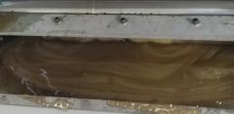
FAQ
Production Anomaly | Cause Analysis | Solutions
Difficult gluing | The glue is not completely melted | The operating temperature is too low, resulting in insufficient glue melting. Increase the operating temperature
 | The hot - melt adhesive is too thick | Increase the operating temperature or reduce the viscosity (thickness) of the hot - melt adhesive
 | The glue film is too thick and the adhesion is too strong | Reduce the thickness of the glue film or increase the temperature to reduce the stickiness of the coating roller
The glue turns yellow | The temperature is too high | Lower the temperature to slow down aging
 | The glue - melting time is too long | Add glue in small amounts and multiple times to avoid adding too much glue at once and not being able to use it up for a long time
Severe stringing | The glue solution is thick, viscous | Increase the operating temperature and reduce the thickness of the glue film

Slide 7
Thank You for Your Attention!
Sichuan UNISN New Material Technology Co., Ltd.
Office Address: Room 806, Building 5, China Railway West City Business District, Qingyang District, Chengdu,
Sichuan Province,
China
Tel: +86 028-81726336 Fax: +86 028-81766336
Mobile: +86 138 8208 4297 Email: unisn@foxmail.com

